Slide 1
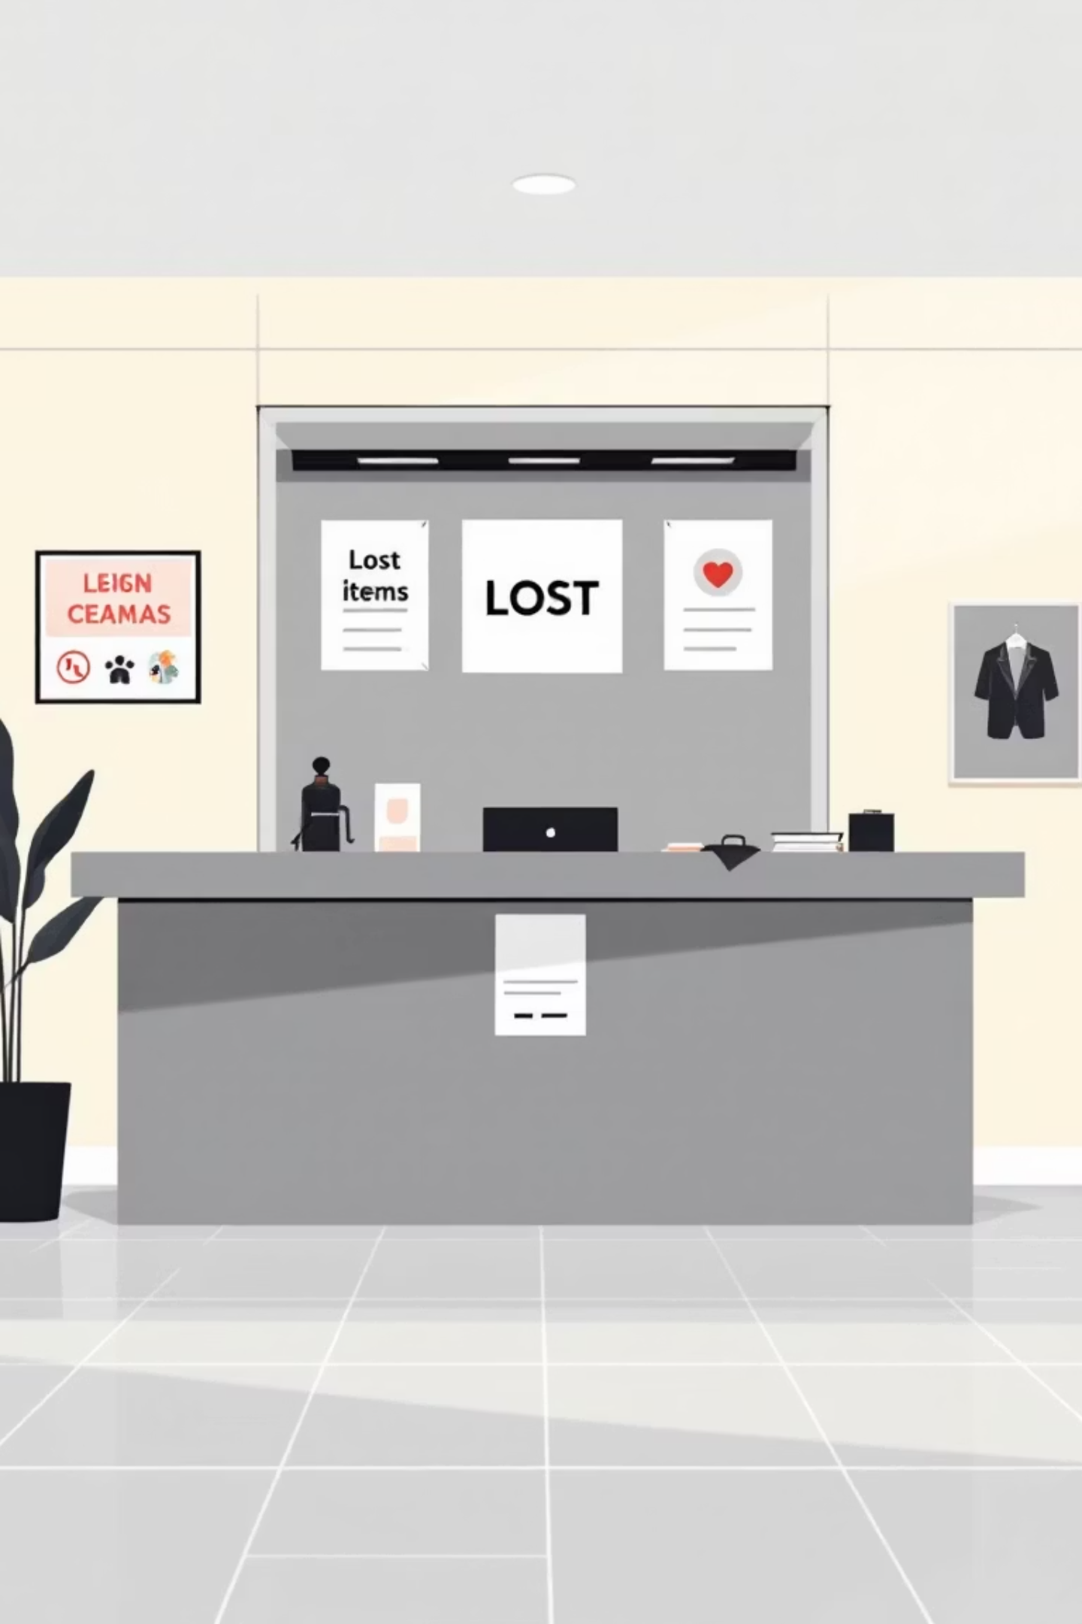
Lost and Found Campus Portal
Project Leads
[Siddharatha Jakku] – 2403A52264
[Vadhan Ganji] – 2403A52266
[Harshavardhan chary] – 2403A52265
Institution: SR UNIVERSITY
A digital initiative to reduce lost item friction across campus

Slide 2

Problem Statement:
-Students and staff frequently misplace personal belongings across campus, causing frustration and inconvenience.
-Current methods for reporting and recovering lost items are unreliable, relying on informal word-of-mouth, physical notice boards, and uncoordinated social media posts.
-This fragmented approach leads to low recovery rates and significant privacy and security concerns regarding personal information and item verification.
-There is a critical need for a centralized, secure, and efficient platform to manage the lost and found process for the campus community.

Slide 3
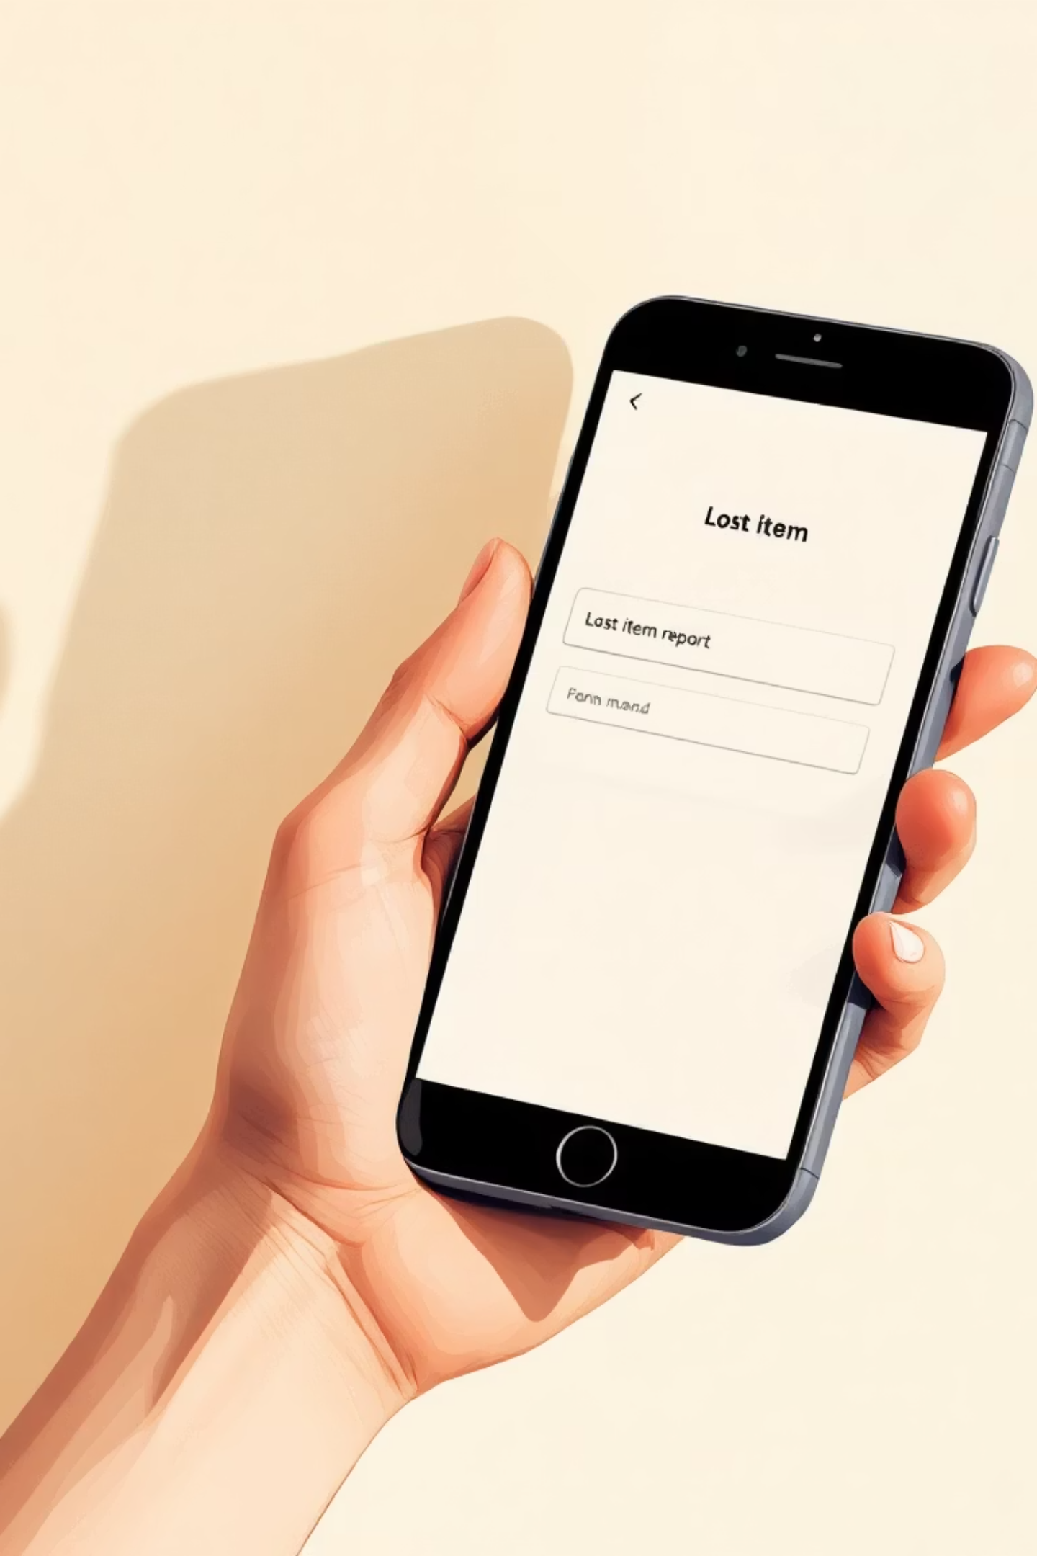
Objectives
Simplify reporting
Make it quick to register lost or found items with photos and descriptions.
Digitise records
Centralised searchable database replacing paper logs and pinned notices.
Real-time updates
Email/SMS notifications and match alerts so owners act quickly.
Transparent tracking
Admin dashboard to manage verifications, claims and reporting metrics.

Slide 4



Project Stakeholders
Students
Campus Security/Administration
Cleaning/Maintenance Staff
Primary users who lose and find items, needing an intuitive reporting and retrieval system.
Often discover lost items during their duties; their involvement ensures efficient reporting and handover of found articles.
Responsible for managing the lost and found process, verifying items, facilitating claims, and ensuring secure storage.

Slide 5
Technology Stack Overview
HTML (HyperText Markup Language)
CSS (Cascading Style Sheets)
GitHub Copilot
An AI-powered coding assistant that significantly boosts development efficiency. It provides real-time code suggestions, autocompletion, and helps generate boilerplate code, allowing developers to focus on complex logic and accelerate the implementation of features for the lost and found system.
Serves as the foundation for the project's user interface, structuring content with semantic tags to ensure accessibility and a logical layout for displaying lost and found items, forms, and user profiles.
Responsible for the aesthetic appeal and responsive design of the application. It ensures a consistent and intuitive visual experience across various devices, styling elements like forms, lists, and interactive components to be engaging and user-friendly.

Slide 6
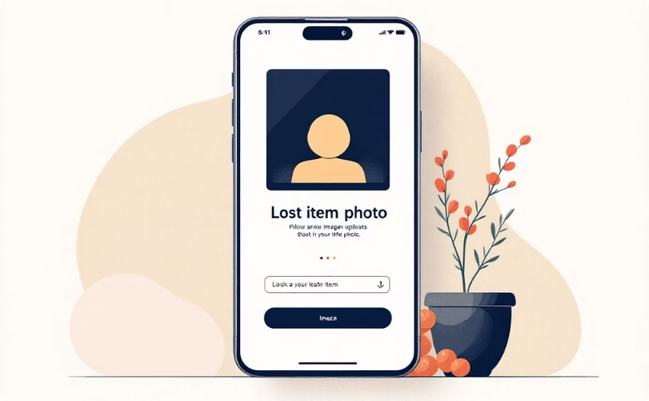
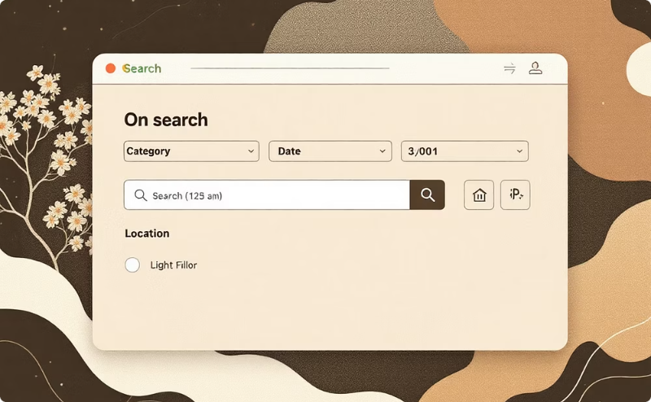


Key Features
Image-first reporting
Search & filter
Notifications
Admin dashboard
Users upload photos; system stores visual data for matching and verification.
Powerful filtering by category, location, date, and tag to find matches fast.
Real-time email/SMS alerts and in-app messages for potential matches.
Approve reports, track claims, view analytics and export monthly reports.

Slide 7
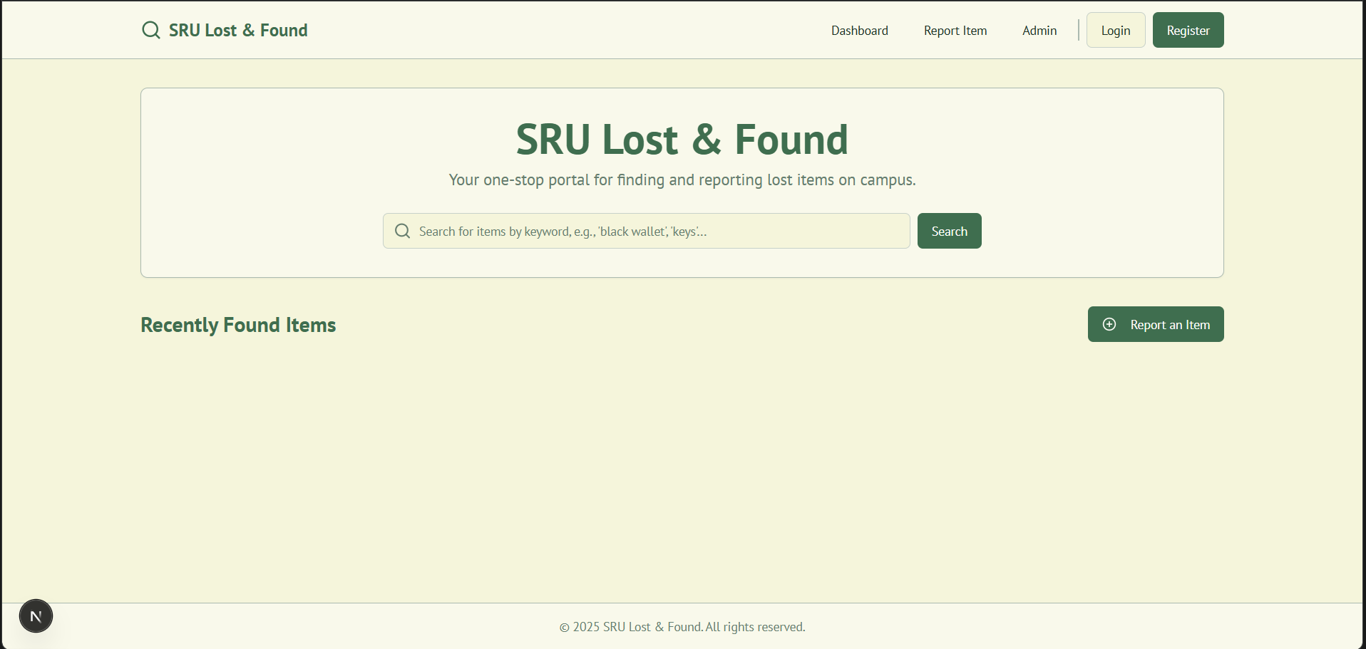
Frontend View of Web Application

